Slide 1
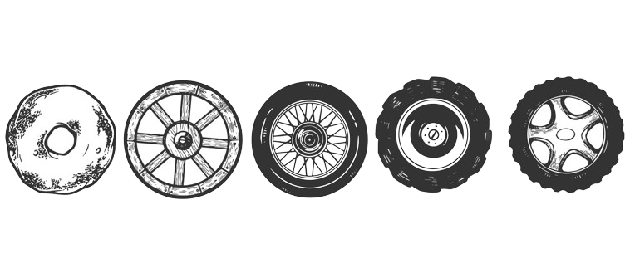
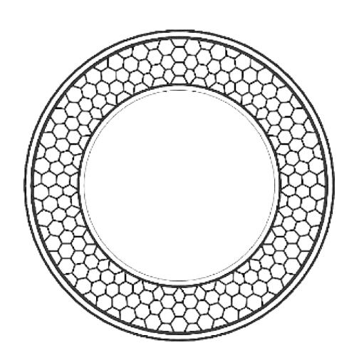

Mid-Term Report

Slide 2


Advanced Non-Pneumatic Tire Design with Honeycomb Structure for Military Applications

Slide 3
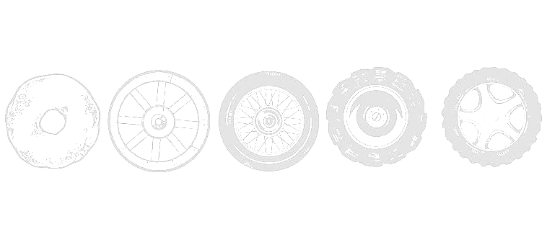

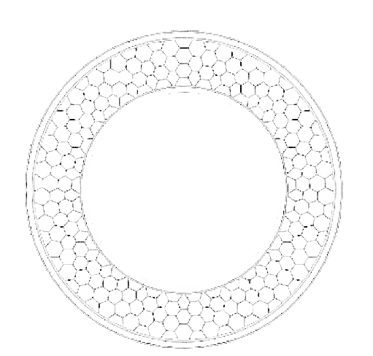
Advanced Non-Pneumatic Tire Design with Honeycomb Structure for Military Applications

Slide 4
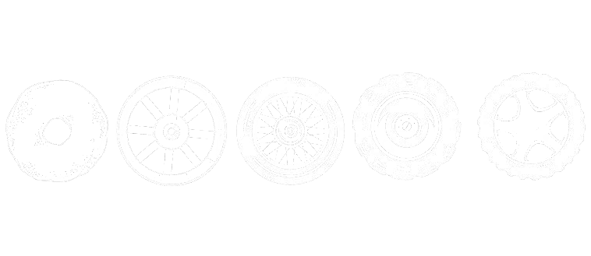




Introduction
Advanced Non-Pneumatic Tire Design with Honeycomb Structure for Military Applications
Submitted by:
Maanik Jain (UEM219081)
Sahil Rangra (UEM219087)
Sangam Sharma (UEM219088)
Supervisor: Prof. Amit Chauhan
Institution: UIET, Panjab University

Slide 5
Introduction
Focus of the Project:
Non-pneumatic tire design with a honeycomb structure
Military applications: rugged terrains, durability, and puncture resistance
Key Goals:
Shock absorption
Load handling improvement
Long-term performance in extreme conditions

Slide 6
Problem Definition
Challenges with Conventional Tires:
Prone to punctures and blowouts
High maintenance in military environments
Solution:
Non-pneumatic tires with honeycomb structure
Increased durability, puncture resistance, and adaptability

Slide 7
Objective
Design a tire with a multi-layered honeycomb structure.
Material selection for strength, flexibility, and stability.
Use of Finite Element Analysis (FEA) to validate performance.
Develop a prototype for real-world military applications.

Slide 8
Literature Review
Existing NPT Technologies:
Use in automotive and military industries.
Benefits of honeycomb structure: load distribution and lightweight properties.
Materials Studied:
Polyurethane, metallic foams, and composites for high-impact resistance and flexibility.

Slide 9
Methodology – Conceptual Design
Design in SolidWorks:
3D model with multi-layered honeycomb structure
Thicker outer layer for wear resistance
Adjustable cell sizes for better shock absorption and load handling

Slide 10
Material Selection
Materials Chosen:
Polyurethane: Flexibility, impact absorption
Metallic foams: Lightweight, structural strength
Carbon fiber composites: High tensile strength, abrasion resistance

Slide 11
Finite Element Analysis (FEA)
Analysis Focus:
Stress distribution and deformation under load
Simulation using ANSYS Workbench
Results showed effective load distribution and durability under high-impact conditions

Slide 12
Work Done So Far
Completed 3D design of the non-pneumatic tire
Initial design is ready in SolidWorks and working on the selection of material to be used in spokes.
Analyzing the load capacity of each material compatible for the spokes.

Slide 13
Challenges Faced
Material sourcing difficulties for prototyping.
Complexity in FEA simulations for real-world scenarios.
Optimization challenges for different terrains and conditions.

Slide 14
Future Work
Refinement of FEA simulations for more dynamic conditions.
Prototype development based on optimized design.
Modular design exploration for terrain adaptability.

Slide 15
Conclusion
Significant progress in the design and material selection phase.
Moving towards prototyping and real-world testing for military applications.

Slide 16



Conclusion

Slide 17
Thank You

Slide 18
Thank You

